Slide 1
Northwind Revenue Improvement
Andrew Smith
North Star Consulting

Slide 2
Introduction The Northwind Database
91 customers in 21 countries
77 food products from 29 global suppliers
2,155 product sales spanning 18 months
9 Northwind Sales Representatives
51,317 units sold
$1,265,793 in revenue

Slide 3
Methodology
1: Ask Questions
From the data available, what questions do we want to explore?
2: Formulate Hypothesis
Based on our question, what is it that we want to prove or disprove?
3: Gather Data
Generating the data we need to explore and answer our question.
4: Visualize
Create graphs to get an idea of whether we’re proving or disproving our hypothesis.
5: Test
Run one or more tests to prove or disprove our hypothesis.
6: Conclusion
Interpret the results of our tests, use those results to answer our original question.

Slide 4
Asking Questions
Question 1
Does discount amount have a statistically significant effect on the quantity of a product in an order? If so, at what level(s) of discount?
Question 2
Do employees have a statistically significant effect on order values? If so, does the employee's region have a statistically significant effect?
Question 3
Does the customer's region have a statistically significant impact on the amount of orders they submit?
Question 4
Did items that are now discontinued have a statistically significant difference on order values?

Slide 5
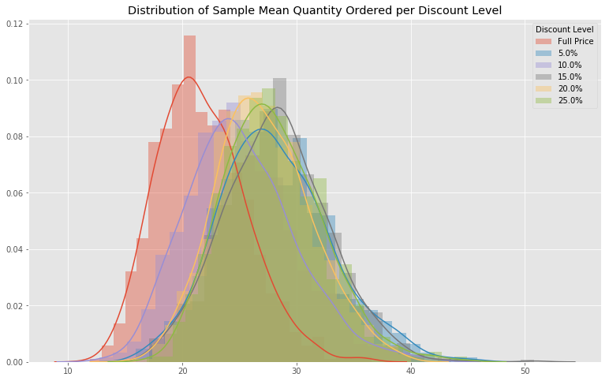
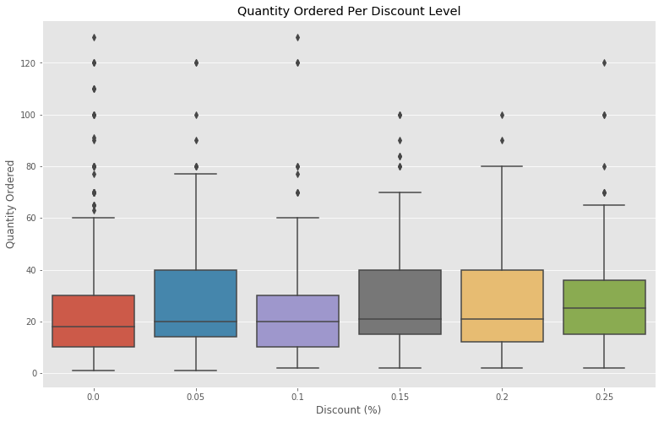
Question 1: Does discount amount have a statistically significant effect on the quantity of a product in an order? If so, at what level(s) of discount?
5

Slide 6
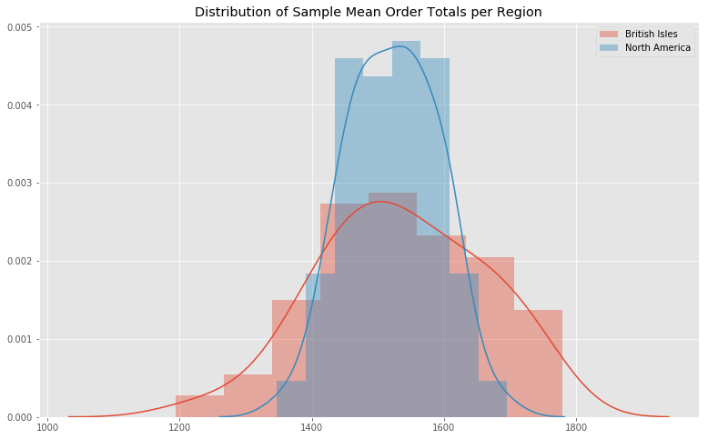
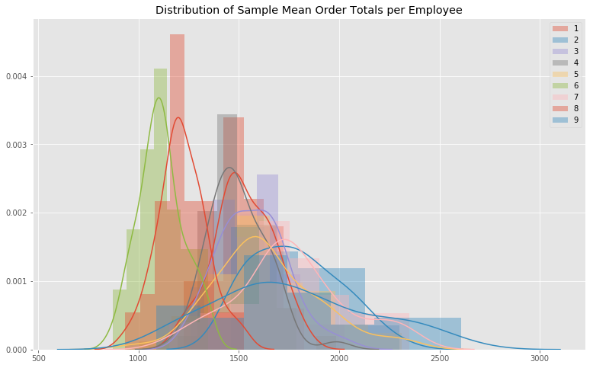
Question 2: Do employees have a statistically significant effect on order values? If so, does the employee's region have a statistically significant effect?

Slide 7
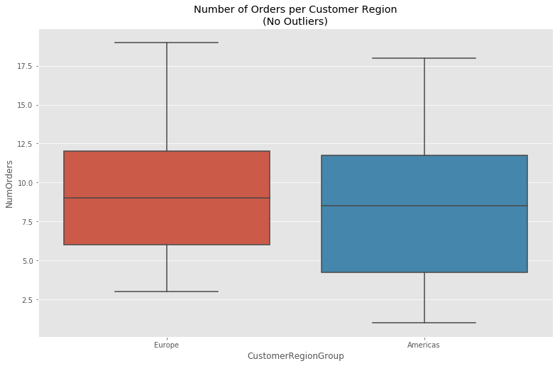
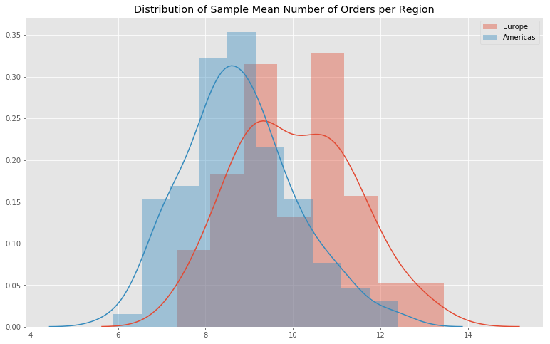
Question 3: Does the customer's region have a statistically significant impact on the amount of orders they submit?
7

Slide 8
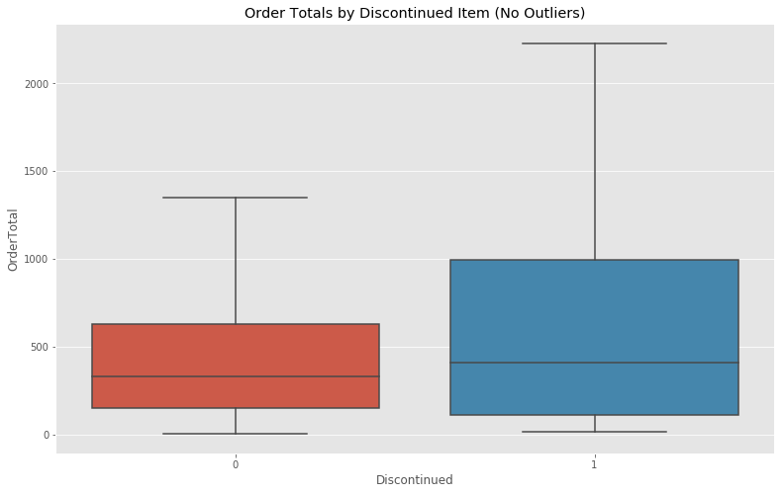
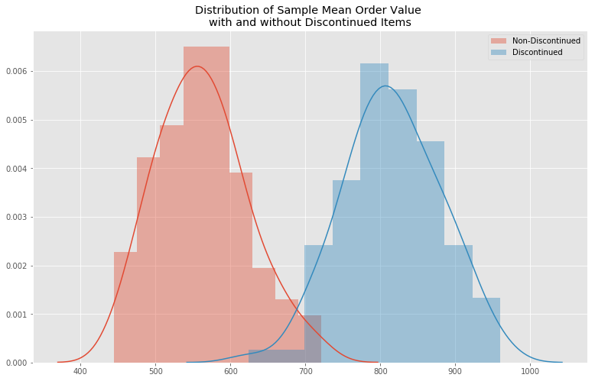
Question 4: Did items that are now discontinued have a statistically significant difference on order values?

Slide 9

Question 1
5%, 15%, and 25% discounts provide the highest increase in quantity sold. 5% provides the highest spread of items sold vs retained revenue.
Question 2
European Sales Reps have both the best and worst average order values. North American Sales Reps are the most consistent, but could still learn from the top European reps.
Question 3
European customers submit the most orders on average. Targeting new European customers should result in higher revenues.
Question 4
Discontinued Items had vastly higher average order values. Bringing as many back as possible should result in more revenue.
Conclusion and Recommendations

Slide 10
Future Work
While plenty of data was gathered that could result in increased revenue for the company, there is still a vast amount of unexplored data in this database. In the future, I would like to dig deeper into the various shipping options, to determine if one of the shipping companies provides cheaper service than the others, and how much each one may affect the likelihood of a customer returning for more orders.
I would also like to discover more data, possibly filling out the customer demographic tables, to be able to explore that as a stronger indicator than just region on how likely a specific customer is to repeat order.

Slide 11

Thanks!
Any questions?

